Slide 1

CYBER EVENTS DATABASE ANALYSIS
Visualizing Cybersecurity Trends (2015-2024)
This Photo by Unknown Author is licensed under CC BY-NC-ND

Slide 2

Introduction
The Cyber Events Database has been taken from CISSM (Center for International and Security Studies at Maryland).
Database Domain: Cybersecurity.
Database URL: https://cissm.umd.edu/cyber-events-database
The Cyber Events Database is an extensive collection of publicly available information on cyber events, covering incidents from 2014 to the present day.
This initiative was developed to address the critical need for consistent, well-structured data essential for making informed strategic decisions about resource allocation for cyber event prevention and response.
This Photo by Unknown Author is licensed under CC BY-NC

Slide 3

Why Cyber Events Database?
The increasing scale and impact of cyber events has become an enduring concern.
Information on the range of threat actors, motives, industries affected, and classified impacts is often scarce, fractured, or available only through expensive private organizations.
Both the private and public sectors face a multi-faceted cybersecurity problem, lacking the basic tools needed to make strategic decisions about prevention and response.
To bridge this gap, the Center for International and Security Studies at Maryland (CISSM) and GoTech launched the Cyber Events Database project.
This database includes information on cyberattacks from 2014 to the present, enabling users to distill analytical insights on cyber threats to specific industries and regions, observe trends over time, and analyze the behavior of different threat actors

Slide 4

Data Collection Method:
Data for the Cyber Events Database is collected using a mixed-methods approach, leveraging automated techniques paired with manual review and classification by researchers.
A customized Python script queries known websites on the open internet and dark web, retrieving relevant data that is then reviewed and coded by the research team.
This ensures that events meet the definition of a cyber event and are consistently categorized. The dataset is updated monthly, providing structured information on threat actors, motives, victims, industries, and the effects of attacks.

Slide 5
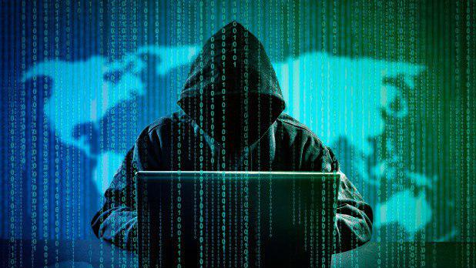
The dataset includes structured information across several categories
Event Date: Date or estimated date of the event.
Year: Year the event occurred.
Actor: Name of the organization or individual responsible.
Actor Type: Nature of the actor (Criminal, Nation-State, Terrorist, Hacktivist, Hobbyist).
Organization: Name of the target organization.
Industry Code: NAICS code defining the target organization.
Industry Name: Name of the NAICS code category.
Motive: Intended results sought by the actor (Protest, Sabotage, Espionage, Financial).
Event Type: Primary effects of the event (Disruptive, Exploitative, Mixed).
Event Sub-type: Further classification of the event's nature.
Event Description: Detailed description of the event.
Source URL: URL from which the data was pulled.
Target Country: ISO country code for the target organization’s location.
Actor Country: ISO country code for the actor’s location.
This Photo by Unknown Author is licensed under CC BY

Slide 6
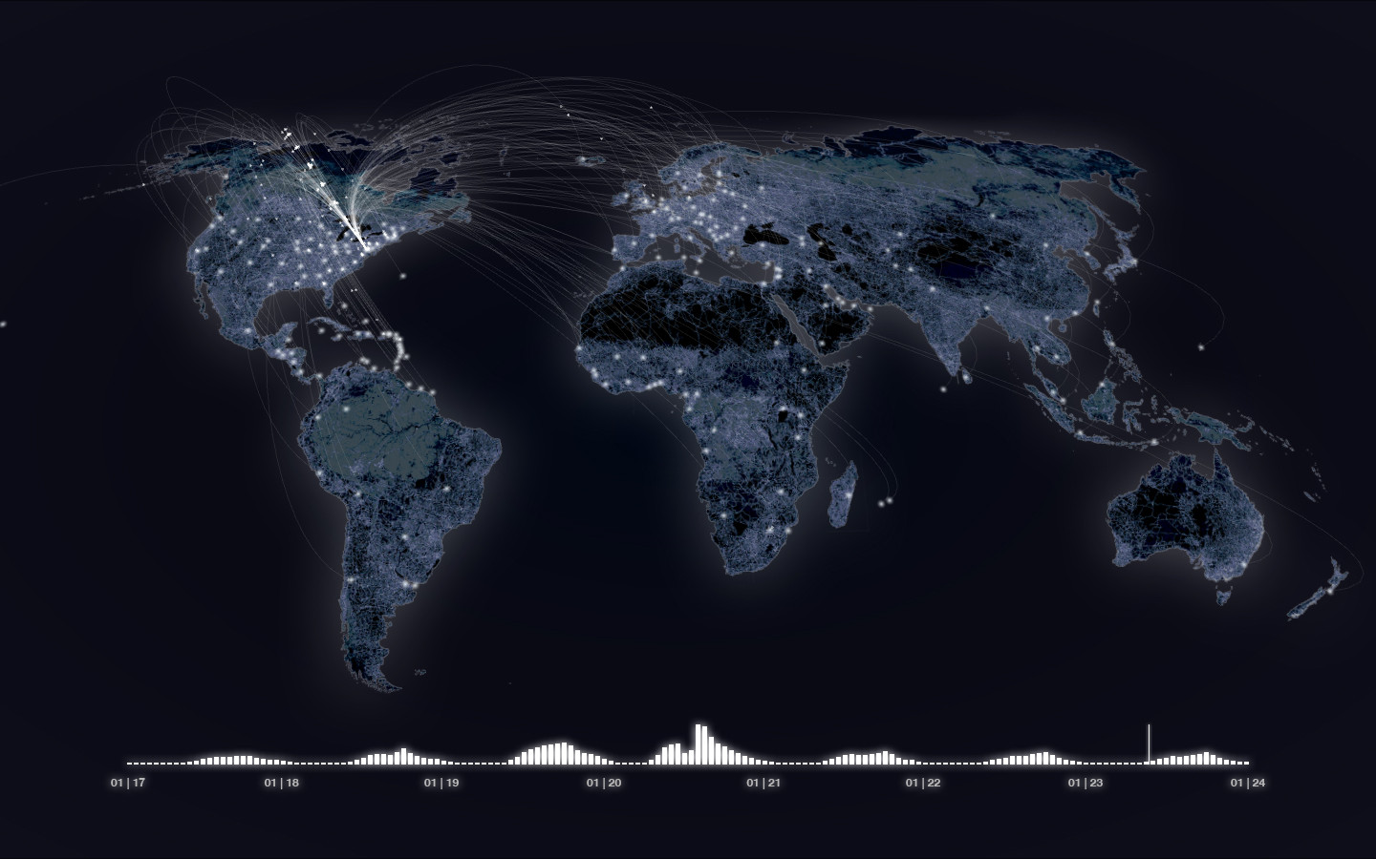
Visualization Tools Selected:
To visualize the data effectively, we utilized Tableau.
This tool enables the creation of interactive and dynamic visualizations that help in understanding complex datasets and extracting meaningful patterns and trends.
This Photo by Unknown Author is licensed under CC BY-SA

Slide 7

Filled Map - Cyber Events by Actor Country and Actor Type (2015-2024)
Goal: To determine the distribution of cyber threat actors across the world.
The filled map illustrates the global distribution of cyber threat actors between 2015 and 2024.
Countries are colored based on the type of actors involved, such as criminals, hacktivists, nation-states, terrorists, hobbyists, and undetermined.
This chart reveals that certain countries, like the United States and Russia, are hotspots for multiple types of cyber threats.
The ability to filter by actor type and year allows us to observe trends over time, showing, for example, an increase in criminals and hackivists in recent years.

Slide 8
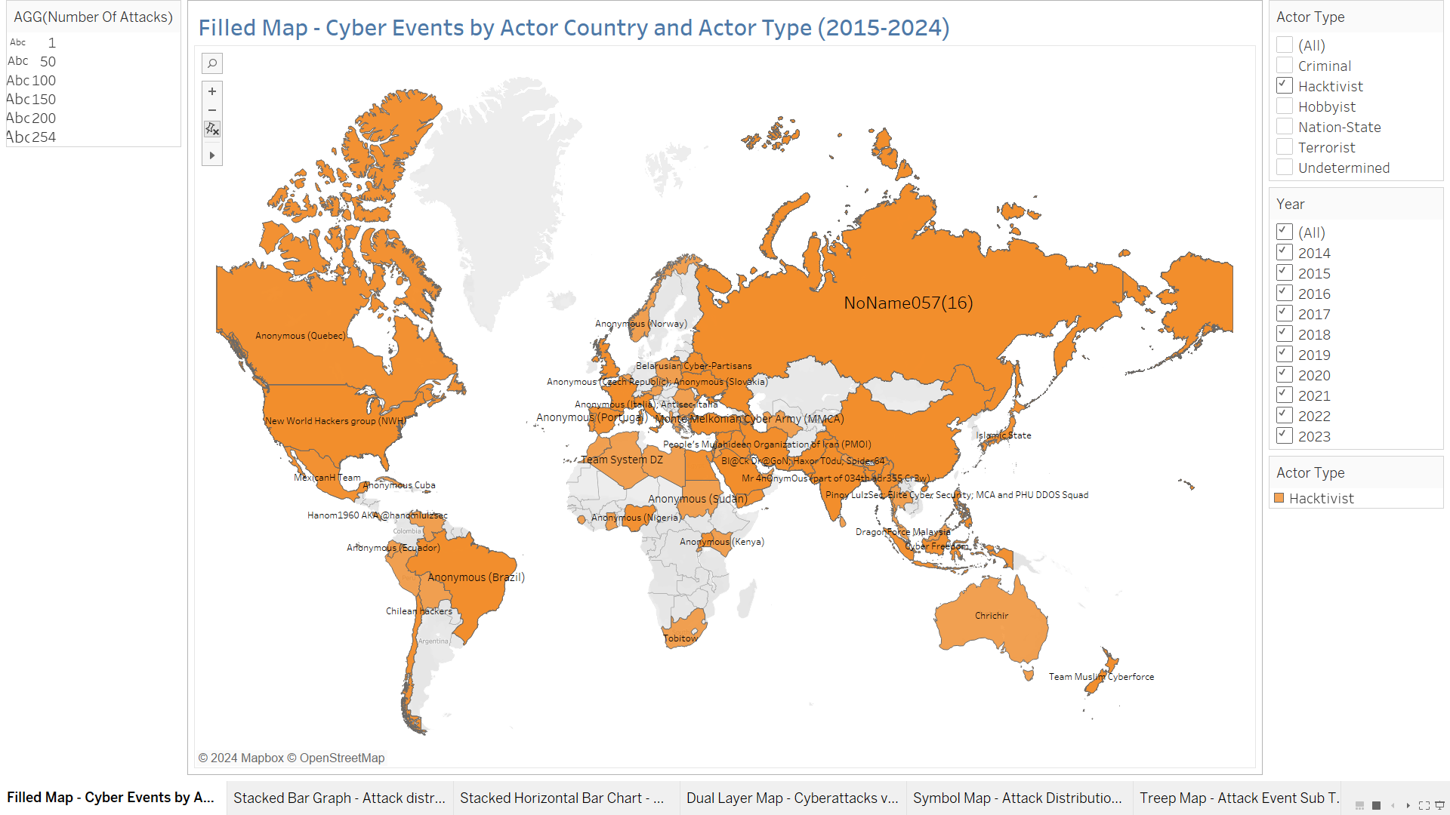

Slide 9

Stacked Vertical Bar Graph - Attack distribution vs Event type:
Goal: To visualize the distribution of cyberattacks over the years, classified by event type (disruptive, exploitative, mixed, undetermined).
By examining the graph, we can see a trend where exploitative attacks have become more prevalent in recent years.
This indicates a shift towards attacks that aim to steal information or exploit system vulnerabilities.
The filters enable a deeper dive into specific years or actor types, revealing, for instance, that criminal actors have consistently favored exploitative attacks.

Slide 10
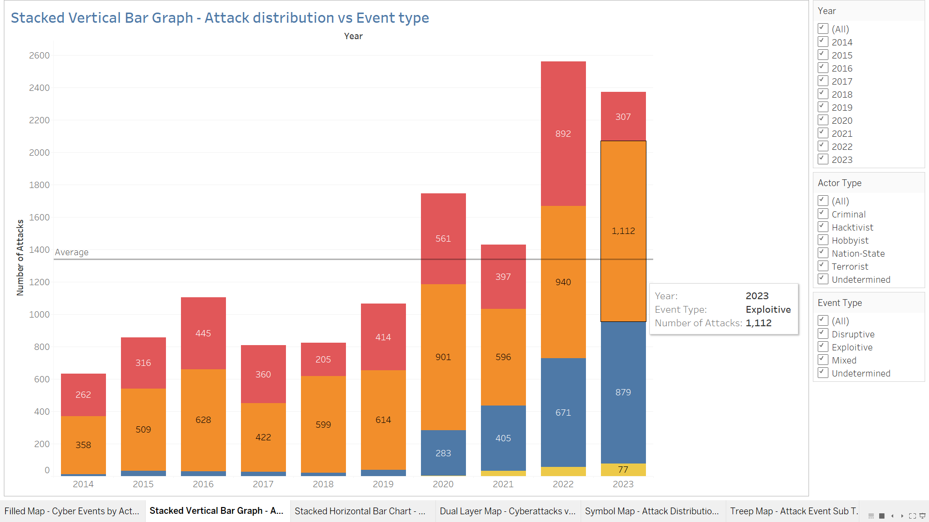

Slide 11

Stacked Horizontal Bar Chart - Cyberattacks, Industry, and Actor Type Distribution:
Goal: To examine the impact of cyberattacks on various industries. Filters for year, industry, and actor type help understand specific patterns and targets.
It is evident that Certain industries, like finance, public administration and healthcare, are more frequently targeted.
The chart also highlights the actor types involved in these attacks, indicating that nation-state actors often target critical infrastructure like public administration while criminal actors focus more on financial institutions.
Using filters, we can identify specific patterns, such as the criminal's favorite targets are healthcare, finance, public administration and education services.
This Photo by Unknown Author is licensed under CC BY-SA-NC

Slide 12
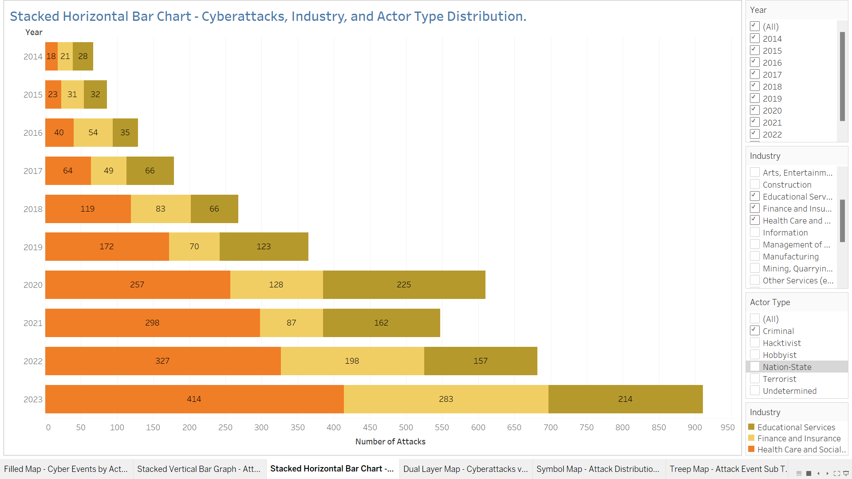

Slide 13

Dual Layer Map - Cyberattacks on Industry Distribution:
To showcase the distribution of cyberattacks on different industries across various regions.
The filled layer, transitioning from blue to red, represents the number of attacks in each country, with red indicating higher attack volumes.
The symbol layer uses bubble sizes to indicate the number of events targeting specific industries in each region.
This map shows that the United States is a major targets for cyberattacks, particularly in the healthcare and public administration sectors, suggesting a need for enhanced cybersecurity measures in these industries.
This Photo by Unknown Author is licensed under CC BY-SA-NC

Slide 14
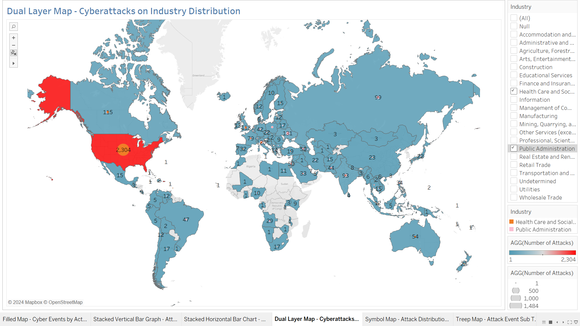

Slide 15
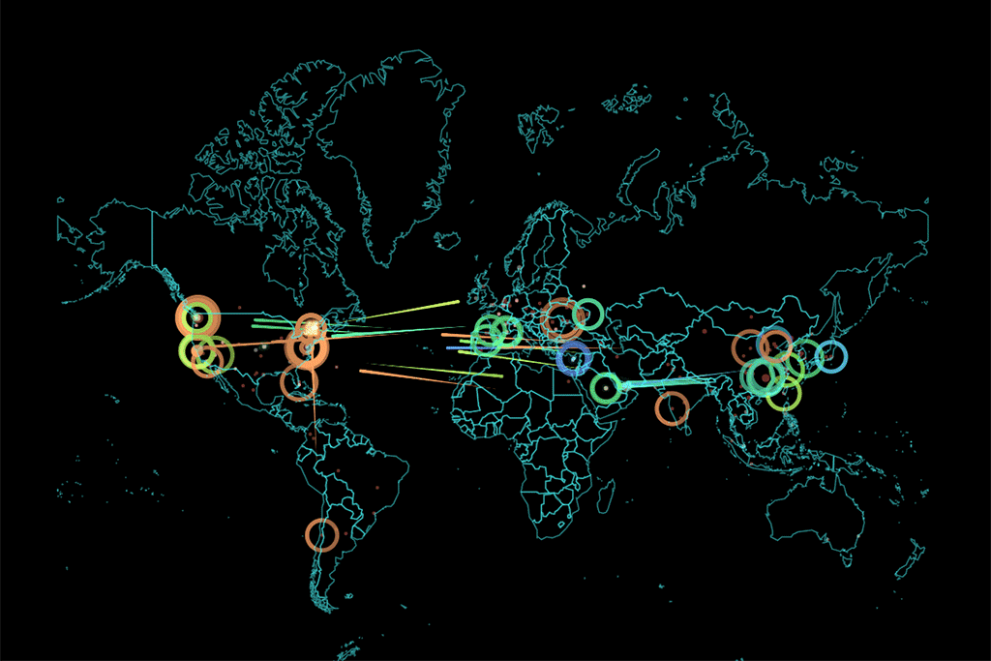
Dual Layer Map - Correlation Between Number of Attacks on a Country and Number of Attacks From That Country:
Goal: To analyze the correlation between the number of cyberattacks a country experiences and the number of attacks originating from it.
The filled map layer highlights the total attacks on each country, while the symbol map layer shows the attacks originating from each country.
A significant observation from this map is that Russia stands out as the largest source of cyberattacks, with 1,741 attacks originating from it, yet it experiences a relatively low number of attacks itself, with only 370 attacks. This asymmetry underscores Russia's prominent role as a major attacker in the global cyber threat landscape while remaining less vulnerable to incoming attacks.
In contrast, the United States experiences a high number of attacks, with 6,479 attacks targeting it, but it is also a significant source of cyberattacks, with 139 attacks originating from it. This duality indicates a complex cyber threat environment where countries can be both victims and perpetrators of cyber incidents.
The contrasting patterns between the United States and Russia highlight different strategic positions in cyber warfare. While the U.S. is heavily targeted, it also contributes to the global volume of cyberattacks, though to a lesser extent than Russia in terms of originating attacks. This dynamic emphasizes the need for international cooperation in cybersecurity efforts to address the global nature of cyber threats effectively.
This Photo by Unknown Author is licensed under CC BY-NC

Slide 16
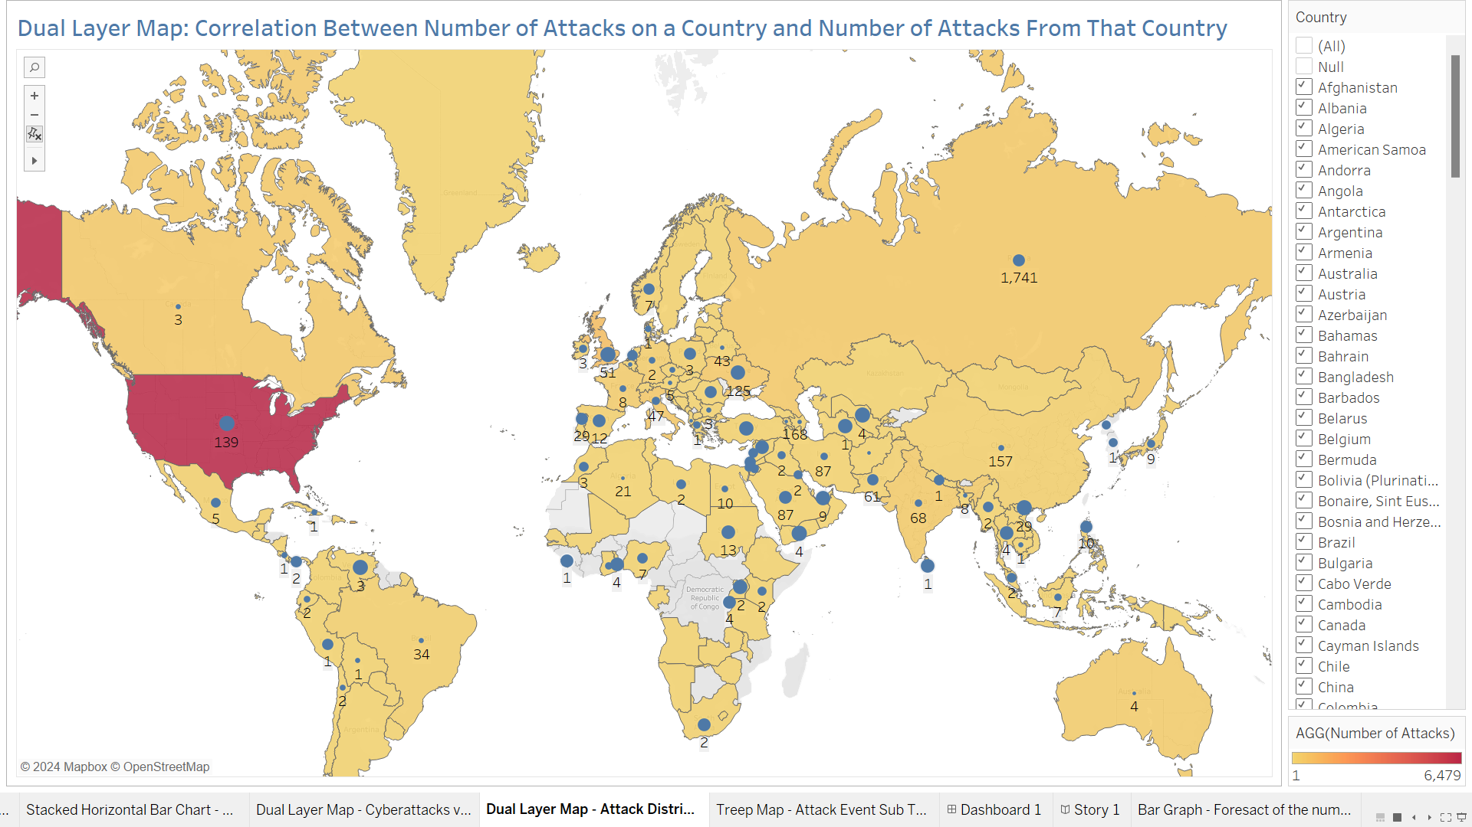

Slide 17

Tree Map - Attack Event Sub Type:
Goal: To identify the most common, cyberattack subtypes. The tree map visualization helps in understanding the prevalent methods used in cyberattacks.
Categorizing these attacks based on their event subtypes, helps us in identifying the methods employed by the cyber criminal’s.
At the forefront of this visualization are the larger blocks, symbolizing the more frequently utilized attack subtypes.
By delving deeper into the branches of this map reveals other significant attack vectors. One such subtype is the exploitation of application servers, which underscores the vulnerability of software systems to targeted intrusions.
Another notable category is data attacks, emphasizing the persistent threat posed to sensitive information. Additionally, message manipulation emerges as a concerning tactic, highlighting the potential for adversaries to manipulate communications for malicious purposes.
Furthermore, the presence of Denial of Service (DoS) attacks on the map signifies the ongoing challenge of maintaining operational continuity in the face of deliberate disruption. Given the prominence of these top attack method subtypes, it's evident that defensive measures should be tailored to prioritize these common threats.

Slide 18
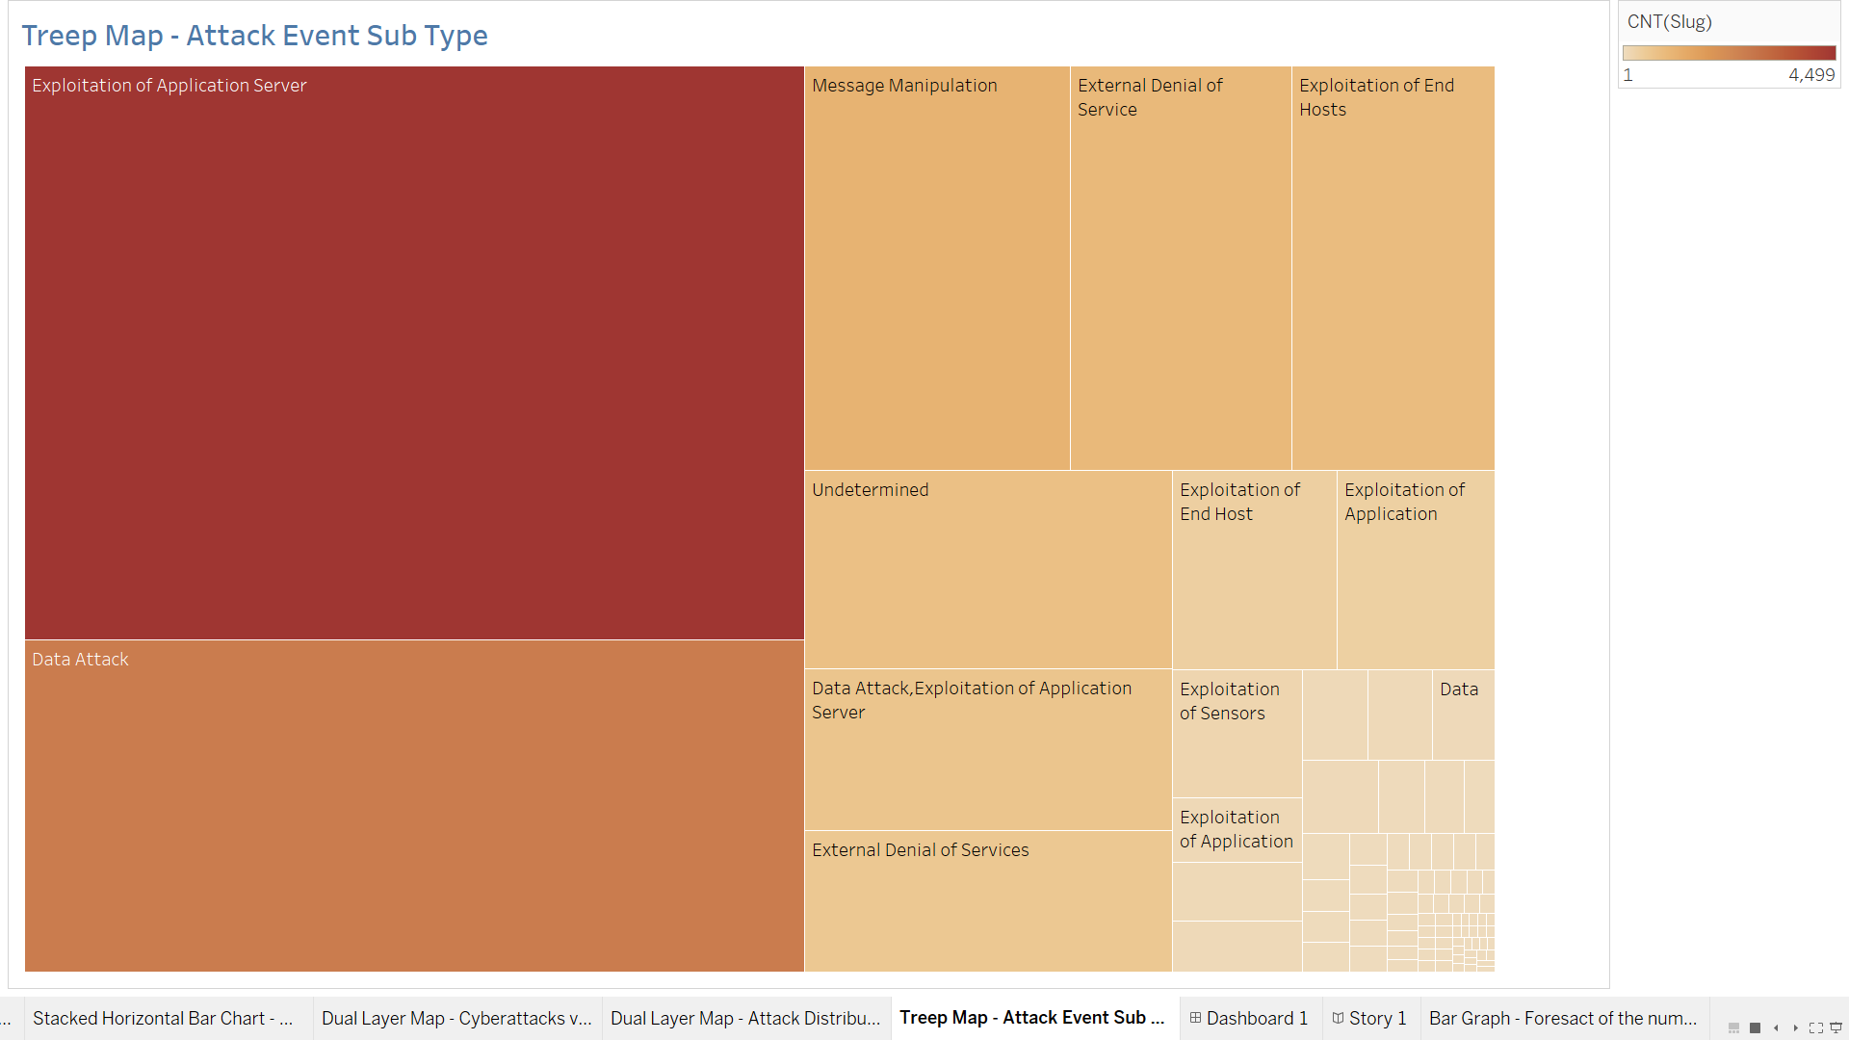

Slide 19
Key Insights:
Global Threat Dynamics:
Certain countries emerge as hubs for cyber threat activity, encompassing a range of actors from criminals to nation-states.
Understanding the global distribution of cyber threats is pivotal for developing comprehensive defense strategies.
Adapting Tactics:
The rise of exploitative attacks signals a shift in cybercriminal tactics towards stealing information and exploiting system vulnerabilities.
Cyber adversaries continually evolve their methods, emphasizing the need for proactive and adaptive defense measures.
Sector-Specific Vulnerabilities:
Industries such as finance, public administration, and healthcare face heightened risks, necessitating tailored security approaches.
Recognizing sector-specific vulnerabilities is crucial for mitigating targeted cyber threats effectively.

Slide 20
Key Insights:
Collaborative Response:
The correlation between attack volumes and origins underscores the importance of international collaboration in combating cyber threats.
Cooperative efforts are essential for addressing the global nature of cyber warfare and enhancing collective resilience.
Strategic Defense Priorities:
Analysis of prevalent attack methods, including exploitation of application servers, data attacks, message manipulation, and Denial of Service (DoS), informs strategic defense priorities.
By focusing on these common attack vectors, organizations can fortify their defenses and mitigate the risk of cyber incidents effectively.

Slide 21

Conclusion:
The analysis of the Cyber Events Database offers critical insights into the multifaceted challenges of cybersecurity.
By understanding global threat dynamics, adapting defense tactics, addressing sector-specific vulnerabilities, fostering collaborative responses, and prioritizing strategic defense measures.
Stakeholders can navigate the cybersecurity landscape with greater resilience and efficacy. In an ever-evolving digital environment, informed decision-making and proactive action are essential for safeguarding against cyber threats and preserving the integrity of critical systems and data.
This Photo by Unknown Author is licensed under CC BY-NC-ND

Slide 22

THANK YOU!
Akash Thanneeru
S569652@nwmissouri.edu

